Slide 1
Battle of Neighborhood
Brooklyn, NY

Slide 2
Introduction
Goal of this project is to explore a different neighborhood of Brooklyn, NY by analyzing population density and number of existing restaurants among the neighborhoods to suggest most suitable good location to open a new Asian restaurant.
Additionally this project will serve as a guide for any newcomer in Brooklyn, NY and assist in exploring the neighborhood as a whole.

Slide 3
Data
Dataset to analyze the neighborhood is extracted from a JSON file https://ibm.box.com/shared/static/fbpwbovar7lf8p5sgddm06cgipa2rxpe.json from which consist of data for all neighborhoods within New York. For this project the focus was on extracting the data for the borough Brooklyn. Python Pandas library are used to achieve this.
Once the data is extracted, leveraging Foursquare API https://developer.foursquare.com/ to find the venues to open Asian restaurant within 500 meters of the neighborhood in Brooklyn
Population density distribution among neighborhood is fetched through web-scrapping from https://www.worldatlas.com/articles/brooklyn-neighborhoods-by-population.html

Slide 4
Libraries, Packages and APIs used
Pandas
Geopy
Json
NumPy
Folium
Requests
Matplotlib
Scikit-learn
Four Square API
Sklearn

Slide 5
Methodology
Data of New York city is read from a json file and is cleaned to retain only the required details of the Brooklyn borough.
Neighborhoods are visualized using Folium
Neighborhoods are explored using Foursquare APIs to find most common categories of venues.
K-means clustering algorithm is used to group neighborhoods into different clusters.
Folium map is used to visualize neighborhoods and their emerging clusters.
The venues in the neighborhoods are filtered to find total restaurants and Asian restaurants.
The neighborhoods are studied to find top most venues in them.

Slide 6
Brooklyn Neighborhoods

Slide 7
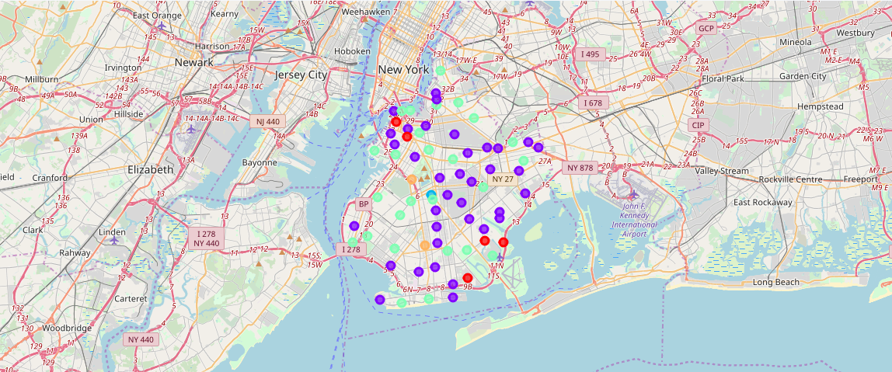
Neighborhood Clusters

Slide 8
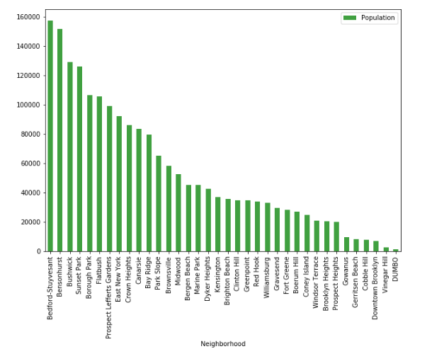
Results

Slide 9
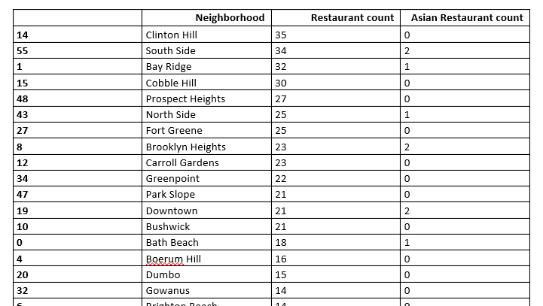
Results (cont..)

Slide 10
Conclusion
This analysis concludes that Clinton Hill is the best option among all the neighborhoods to open a new Asian restaurant followed by Bay Ridge and Cobble Hill. As these neighborhoods have the greatest number of restaurants in Brooklyn so opening a new restaurant with Asian cuisine will provide one more option to the customers.
Even though South Side ranks second in the list but as it already has two Asian restaurants so opening a new restaurant here will face more competition.
Population distribution among these neighborhoods suggests that after Clinton Hill, Bay Ridge is a better option rather than Cobble Hill as it is more densely populated.

Slide 11
Thank You

